Slide 1




APPLICATION
GROUP CERTIOREM
SECRETARY

Slide 2
01. OUR TEAM
04. SNEAK PEEK
02. ABOUT THE PROJECT
05. PROJECT PROCESS
03. MAJOR REQUIREMENTS
06. PRODUCT DEMO
Who are we?
Short video Of the product.
Overview of the project.
Execution of the project.
Requirement of the final project.
Realtime demonstration of the product.

Slide 3

OUR TEAM
Batshal Bhattarai
David La Gordt Dillie
Florin Valantine Deleanu
Menderes Saçli
Tsanko Nadelchev

Slide 4
ABOUT THE PROJECT
Client
End User
Product
Jan Willem Van Silfhout representing Sioux Technologies
Secretary at Sioux
(Sean)
Web application

Slide 5
MAJOR REQUIREMENTS
01
02
03
Add, Edit, Remove Appointments
License plate recognition
SMS/WhatsApp Messaging
04
05
06
Desktop pop-up notification
SSO Outlook

Slide 6
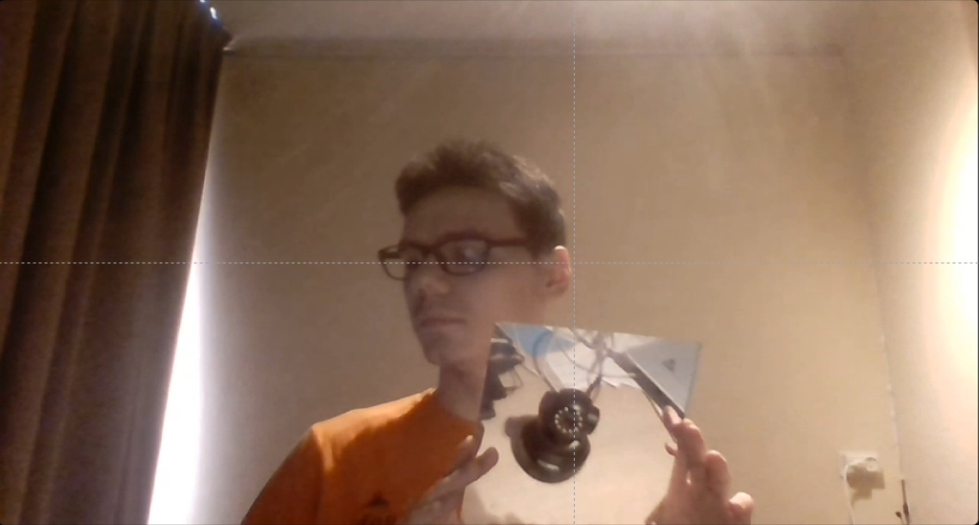

SNEAK PEEK
Short video showing how the application works using a live feed of a ip camera.

Slide 7

PROJECT PROCESS
Techniek
Planning

Slide 8
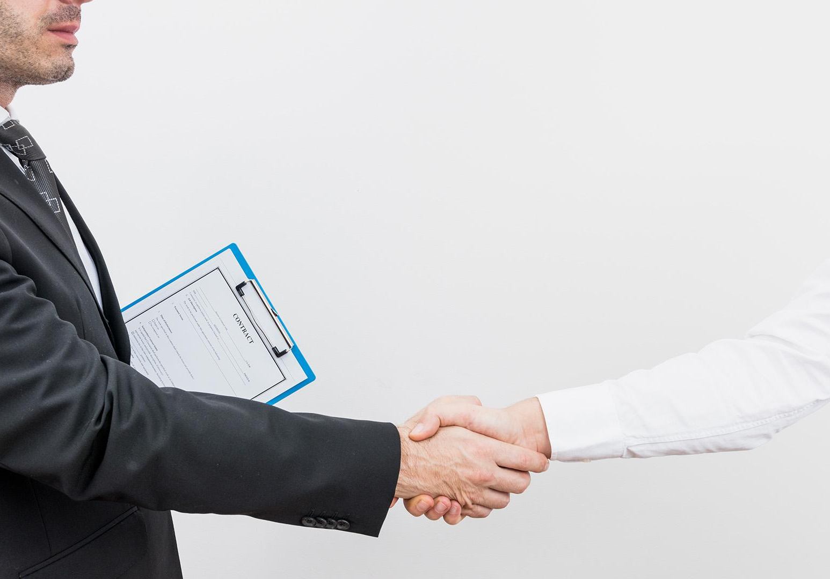
DEMO

Slide 9

THANKS!
Do you have any questions?
Team Certiorem
Batshal Bhattarai
David La Gordt Dillie
Florin Valantine Deleanu
Menderes Saçli
Tsanko Nadelchev

Slide 10
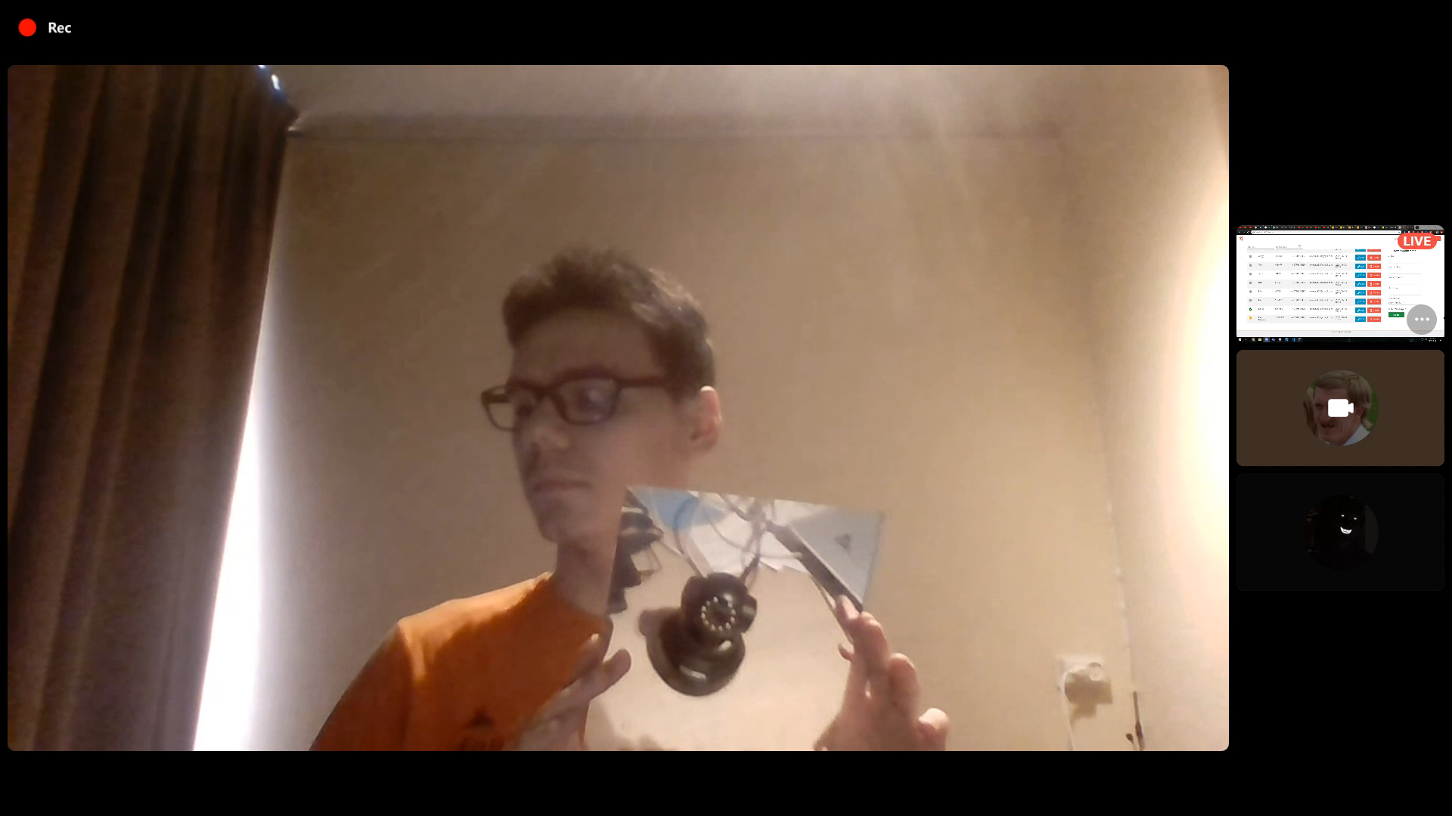
Go Back

